Slide 1
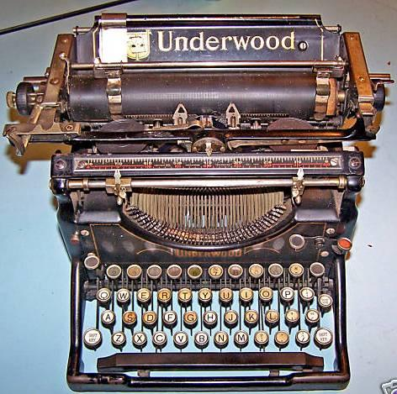
QWERTYUIOP
By: Vivien Alcock

Slide 2

Synopsis
‘QWERTYUIOP’ is about a poor, young graduate named Lucy Beck who has just finished her ‘O’ levels at Belmont Secretarial College. She is a slow learner herself but she is determined to find a job in order to get out of poverty. Fortunately, she is offered a job by Mr. Ross, the Manager of Ross and Bannister’s. However, she begins to face problems from her first day of work. She encounters many peculiar incidents when she starts using the electric typewriter. Whenever Lucy types, the words “QWERYUIOP” which is on the top lines on the keyboards will keep on appearing.

Slide 3

She is determined to keep on her job, so she tries to overcome her fear. Later, she finds out that there is a spirit lingering around the office. She finds out from that Miss Broome, a former secretary of the late Mr Bannister was forced to retire after working for forty-three years. That was why the spirit of Miss Broome is adamant in holding on to her position as the company’s secretary. Towards the end of the story, Lucy tries to get rid of the spirit that has been haunting that place for many years. She assured Miss Broome that the late Mr Bannister needs her in the afterlife. She managed to convince Miss Broome to leave and finally she could maintain her job.

Slide 4

Setting
The story was set in a small town, Belmont and
it revolves around two main settings:
Lucy’s house which she shares with her mother and her Uncle Bert, in a poor neighbourhood
The office of Ross and Bannister’s where Lucy works as a secretary. It is a small firm which is over thirty years old.

Slide 5

Plot
Exposition:
The main character, Lucy Beck is introduced and she lives with her mother and uncle. She has completed her secretarial course and wants a job. She is tried living in poverty and wants to lead a better life.

Slide 6

Rising Action
Lucy managed to get a job as a secretary at Ross and Bannister’s after being interviewed by Mr. Ross. Harry Darke explained to Lucy that she needs to use the typewriter to do her work. Whenever Lucy types, the typewriter tries to control her. The word “QWERTYUIOP” keeps on appearing each time she types. Lucy types questions in order to investigate the mystery behind it. Harry Darke informs her of the old former secretary, the late Miss Broome, who was forced to resign.

Slide 7

Climax:
Lucy is determined to defend her job and she started to type another copy by fixing her eyes on the keys. She was surprised when the typewriter typed out a threatening note. Through the battle of wits between Lucy and the spirit of Miss Broome at the typewriter, Lucy managed to gather all her courage. She erased all the words and she managed to type all her letters and sent it to be signed by Mr Ross.

Slide 8

Falling Action:
Lucy feels sorry for Miss Broome after she heard about Miss Broome’s loneliness and depression after losing her job. She sympathized Miss Broome and tries to persuade her to leave in peace. Lucy convinced her that
Mr Bannister needs her help in the afterlife.

Slide 9
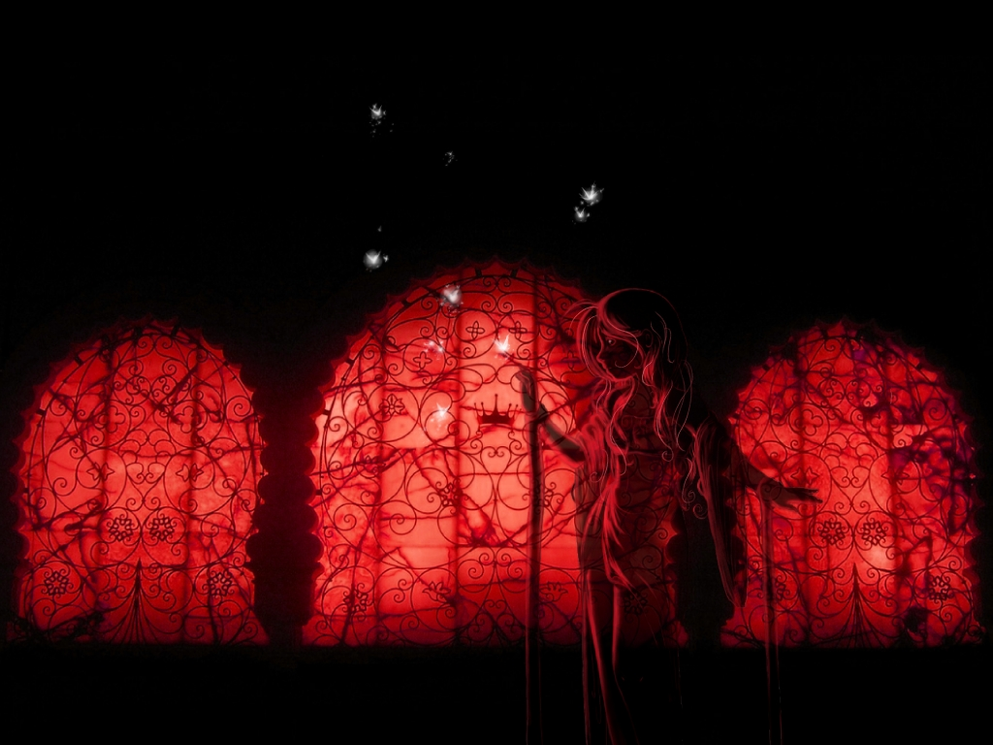
Resolution:
The typewriter become silent and Lucy types a goodbye note to Miss Broome. There was no reply and Lucy was relieved as she has finally helped the spirit of Miss Broome to find peace at last.

Slide 10

Characters
Lucy Beck
A young seventeen year old lady who got a job as a secretary at Ross and Banister’s.

Slide 11

Characteristics:
She is a young, shy, a low achiever, not competent and highly qualified and insecure graduate of secretarial studies.
She has a very low self esteem, inferior complex, no confidence and pessimistic.
She became ambitious, determined and optimistic to change her life style.
Lucy becomes enthusiastic and a quick learner when she got a job. She also became courageous when she has to face the conflict with the spirit of Miss Broom.
Lucy became sympathetic, caring, insightful and understanding after knowing Miss Broome’s history. She took the initiative to look for an amicable solution.

Slide 12

Ghost of
Ms. Broome
The spirit of Ms Broome who haunts the office where she once worked 43 years as she is so attached to her job.

Slide 13

Characteristics:
Loyal, dedicated and took her job seriously at Ross and Bannister’s.
Lonely as she had no family and friends.
She is persistence, vengeful and also possessive over her secretarial job at Ross and Bannister’s.
Finally she is convinced that she should leave as her help is needed.

Slide 14

Harry Darke
Ross and Bannister’s handyman. He is an old man who has been working with the company for years.

Slide 15

Characteristics:
Helpful and concern
A loyal worker at Ross and Bannister’s.
Encouraging and supportive to his colleague

Slide 16

Mrs. Beck
She is a patient and hardworking housewife who live a hard life. She has to support her brother.
Characteristics:
Content with her status in life.
Forgiving and compassionate
Patient

Slide 17
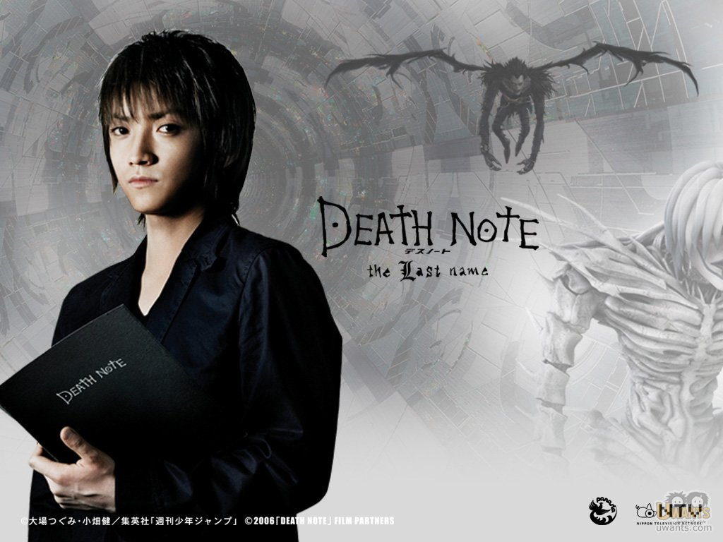
Uncle Bert
A drunkard man who depends on his sister for support.
Characteristics:
- Dependable and irresponsible
- Caring

Slide 18
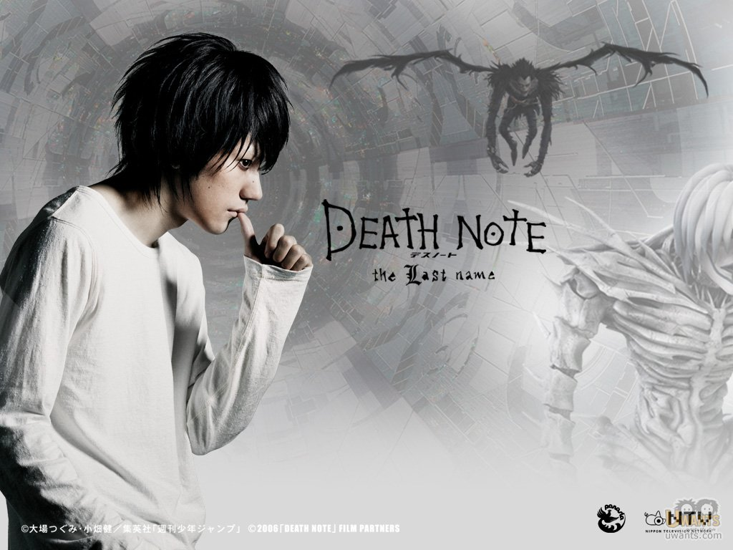
Mr. Ross
Lucy’s boss
Characteristics:
Accommodating and concern

Slide 19

Themes
DETERMINATION
Lucy has strong determination to keep her job as secretary of Ross and Bannister’s despite the supernatural forces that tries to fail her. Miss Broome’s spirit lingered in the room where Lucy works and demands her to leave but she shows no signs of giving up. Lucy is steadfast in defending her position as the secretary and she battled fearlessly with the spirit of Miss Broome who haunted the typewriter that Lucy was working on. Due to her strong determination, she managed to hold on to her job at the firm.

Slide 20

FAMILY LOVE AND CARE:
Lucy’s mother is a responsible lady who takes care of Lucy and her brother despite of the hard life they have to go through. She manages to keep the bond of family love by forgiving Uncle Bert and accepting him back into the family. Lucy also regretted for being rude to Uncle Bert when she sees his shaking hands and miserable eyes, she apologizes and maintain the family bond. Lucy loves her mother and shares her happiness with her mother when she was successful of obtaining a job as a secretary.

Slide 21

COMMITMENT AND LOYALTY:
Lucy and Miss Broome are both committed and loyal to their profession. Lucy takes her work seriously and does the job of typing which was given to her successfully. She has to face the battle with Miss Broome who is still attached to her work even after her death. Lucy did not give up even when Miss Broome demanded her to leave. Miss Broome was so possessive towards her job and also extremely loyal towards Mr. Bannister. Lucy managed to convince her that the late Mr Bannister needs her so she left the office in order to continue her service to Mr Bannister in the after life.

Slide 22

LONELINESS:
Miss Broome has no friends and family members, so she commits herself to her job seriously and made the office her home. She became so attached to her position in the office and the feel of possessiveness went beyond the grave. Uncle Bert also felt the loneliness in life and became so dependable on his sister, Mrs Beck.

Slide 23

THE SUPERNATURAL
Supernatural is being above or beyond what is unexplainable and natural by natural law. The character of Miss Broome in this story is presented as an ethereal entity. Her spirit lingered in the office where she used to work and haunts the new young secretaries who are supposed to replace her. She writes nasty messages and tries to drive away those who were choose to replace her. She instill the fear and eerie feelings in their hearts to frighten them.

Slide 24

COMPASSION:
The theme of compassion is revealed in the final confrontation between Lucy and Miss Broome. After hearing about Miss Broome’s life history from Harry Darke, Lucy became sympathetic and understanding. She interacts with the spirit of Miss Broome through typing on the typewriter and finally she managed to convince her of leaving the place. She told her that Mr Bannister needs her in the afterlife and the spirit left in peace. Compassion is also revealed by Mrs Beck to her brother who is lonely and needed a place called home. Lucy also had compassion towards her Uncle Bert and sympathize him as he is a lonely person who has no place to go.

Slide 25

Moral Values
In order to be successful in life, we need to have a positive mind set.
On our journey to success, we need to have high level of positive self esteem.
In communication, be compassionate not aggressive as compassion heals while aggression causes hurt.
Appreciate and compliment others accordingly.
Preserve the family ties and unity through understanding and forgiving.
Do not judge a book by its cover.
We should not underrate people and their creativeness or abilities.

Slide 26
Where did Lucy graduated?
Describe Lucy’s home and why she wants a job?
3. Who is the manager of Ross’ and Bannister?
Where is the setting of the story?
What kind of worker Lucy is?
How long did Ms. Broome work as a secretary for Mr. Bannister?
What word keeps on appearing each time Lucy types?
Why is Lucy feels sorry for Ms. Broome?

Slide 27
9. How does Lucy managed to convince Ms. Broome of leaving the place?
10. Do you think it was fair to ask Ms. Broome to leave?
11. What is the theme of the story?
12. Briefly explain what you understand about the story.

Slide 28
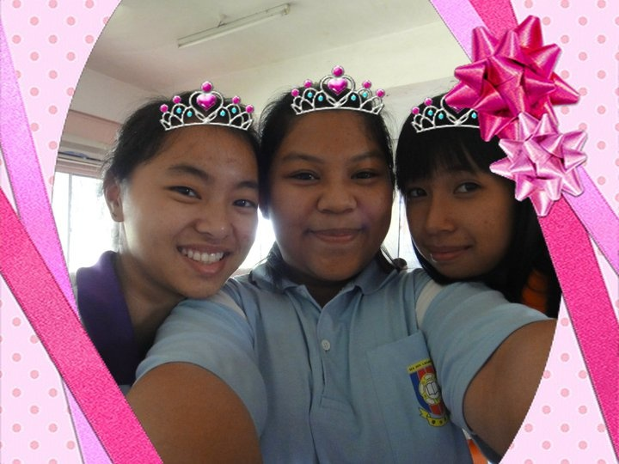
By : Charlie Lim Choi Ni
Leong Po yee
Jeanette Delrio

